Slide 1
Analysis of Bisphenol A and Conjugates in Human Serum
Ruth Muchiri
9/24/2021

Slide 2
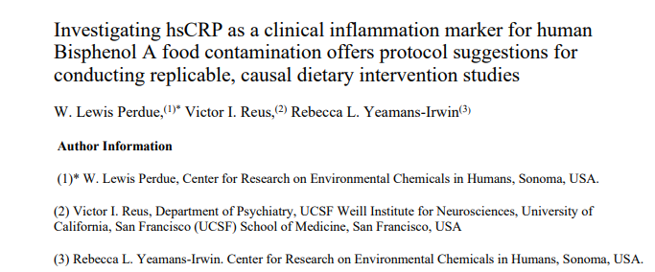
Background
Dietary intervention study to explore a potential causal relationship between human serum levels of BPA and High-Sensitivity C-Reactive Protein (hsCRP), a proven clinical indicator of inflammation.

Slide 3
Analytes of Interest
Bisphenol A (BPA)
Bisphenol S (BPS)
BPA-monosulfate
BPA-disulfate
BPA-monoglucuronide
BPA-diglucuronide
BPS-monoglucuronide

Slide 4
Extraction method
Blank serum or sample (100 µL) added to polypropylene microcentrifuge tubes
Internal standard working solution added (was prepared in 50% aq. acetonitrile: (final concentration; d6-BPA at 100 ng/mL and ¹³C₁₂-BPA monoglucuronide at 40 ng/mL)
Standards or QC samples, at different concentrations (volume was uniform at 20 µL each) was added
Protein precipitation done using 800 µL acetonitrile containing 0.1% formic acid
Samples vortex-mixed on high for 2 minute
Samples put in the freezer for 1 h, centrifuged for 30 minutes at 13,000 ×g and 4 °C.
Supernatant transferred to a clean tube and dried under vacuum in the speed vac
Samples reconstituted in 200 µL mobile phase solvent (water:acetonitrile 1:1 v/v)
Aliquots (5 µL) analyzed by 8050 QQQ LC-MS

Slide 5
UHPLC Method
Shimadzu 8050 QQQ used for the analysis
Mobile phase composition:
Aqueous – 1 mM ammonium acetate in water
Organic – Acetonitrile
Column: Shimadzu Shim-pack XR ODS III C18, 2.0 mm × 75 mm; 1.6 μm
Flow rate: 0.35 mL/min, oven temp: 40 °C
Injection volume: 5 µL
Gradient:
Time (min) | Organic phase (%)
0.01 | 20
2.0 | 40
3.0 | 90
4.0 | 90
4.1 | 20
5.0 | 20

Slide 6
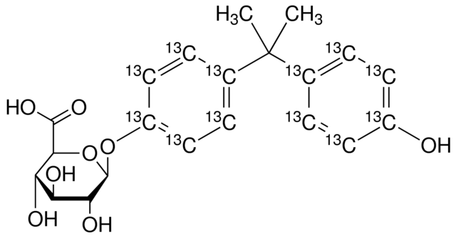
BPA and BPA-monoglucuronide Standards Spiked in Blank Human Serum
5000
BPA-β-ᴅ-Glucuronide
4 ng/mL
2500
403 >227 (-) CE: 29.0
0
¹³C₁₂-BPA-β-ᴅ-Glucuronide
40 ng/mL
50000
25000
415 > 239 (-) CE: 30.0
SRM Response
0
BPA
4 ng/mL
2500
227 > 212 (-) CE: 18.0
0
75000
d6-BPA
40 ng/mL
50000
233 > 215(-) CE: 18.0
25000
0
0.0
0.5
1.0
1.5
2.0
2.5
3.0
3.5
4.0
4.5
Retention time (min)

Slide 7
Background noise: Aqueous acetonitrile
BPA-β-ᴅ-Glucuronide
¹³C₁₂-BPA-β-ᴅ-Glucuronide
BPA
d6-BPA

Slide 8
Extracted Blank Serum Containing Spiked Internal Standards

Slide 9
Example: Serum Sample #2 Chromatogram

Slide 10
Recovery of Spiked Standards
QC | ng/mL | % Recovery
 |  | BPA | BPA-mono glucuronide
LLOQ | 0.50 | 90.1 | 120
Low | 5.0 | 86.1 | 112
Medium | 50 | 82.1 | 106
High | 500 | 102 | 104
Data is an average of 3 technical replicates

Slide 11
BPA Standard Curve and Sample Data
4.0
Unknown serum sample # | BPA (ng/mL)
1 | <LLOQ
2 | <LLOQ
3 | <LLOQ
3.0
Area Ratio (BPA/d6-BPA)
2.0
1.0
0.0
0
100
200
300
400
500
BPA (ng/mL)
Standard curve range: 0.5 – 512 ng/mL

Slide 12
BPA-monoglucuronide Standard Curve and Sample Data
2
1
0
Unknown serum sample # | BPA-monoglucuronide (ng/mL)
1 | <LLOQ
2 | <LLOQ
3 | <LLOQ
Ln(BPA-G/[¹³C₁₂]-BPA-G)
-1
-2
-3
-4
0.0
1.0
2.0
3.0
4.0
5.0
Ln[BPA-glucuronide]
Standard curve range: 0.5 – 512 ng/mL
BPA-G = BPA-monoglucuronide

Slide 13
BPA-Conjugates in Serum Sample – Scan Mode on 9030 Q-ToF
Analyte | [M-H]⁻
¹³C₁₂-BPA-G | 415.1790
d6-BPA | 233.1455
BPA-DS | 387.0286
12C₁₃-BPA-β-ᴅ-Glucuronide
d6-BPA
500 µL serum sample was extracted and reconstituted in 100 µL 50% aq.acetonitrie
BPA-Disulfate

Slide 14
BPA-Conjugates in Serum Sample – Scan Mode on 9030 Q-ToF
Analyte | [M-H]⁻
BPA-G | 403.1385
BPA-DG | 579.1719
BPA-S | 307.0645
BPS-G | 425.0547
BPA-monoglucuronide
BPA-diglucuronide
BPA-monosulfate
There were no BPA conjugates observed in the serum samples analyzed
BPS-monoglucuronide

Slide 15
Additional data for BPS and BPF

Slide 16
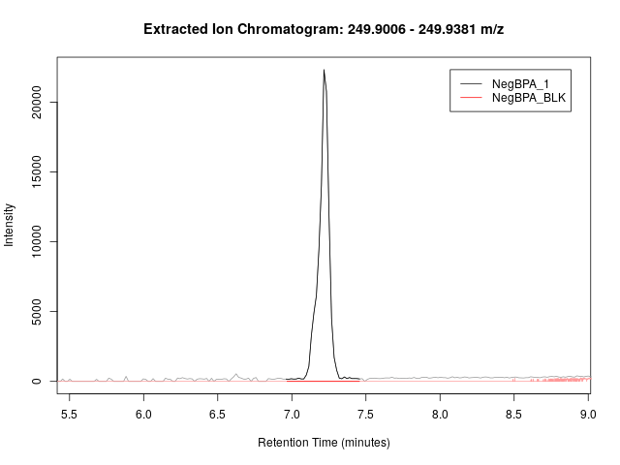
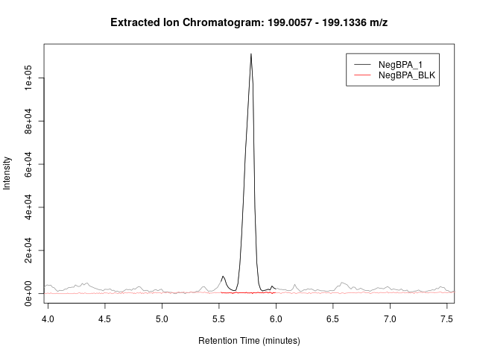
249.9046
7.22
5.76
199.0156
Weak in sample 1
Absent in #2
Present in #2

Slide 17
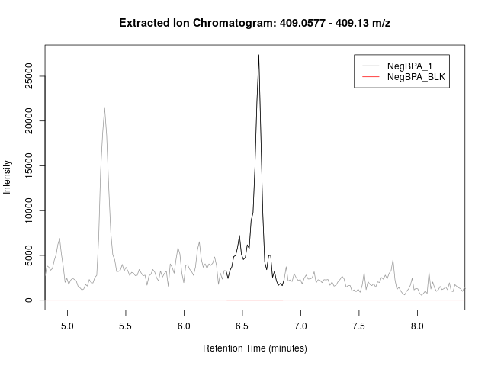
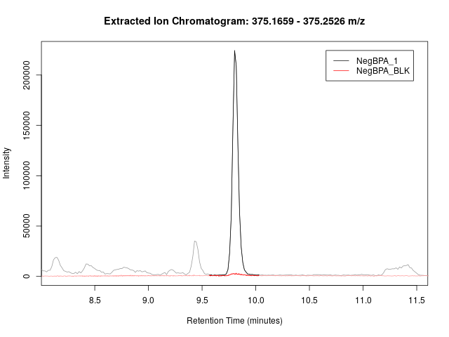
9.80
409.0676
6.61
375.2464
Weak in sample 1, the mass is way off
Present in #2 as 375.2452

Slide 18
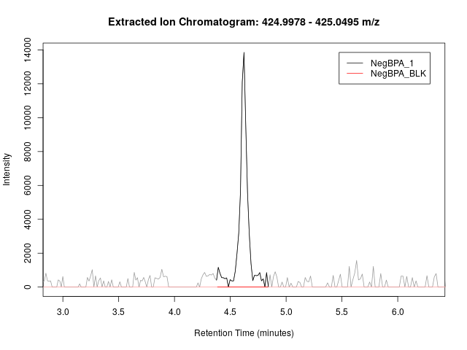
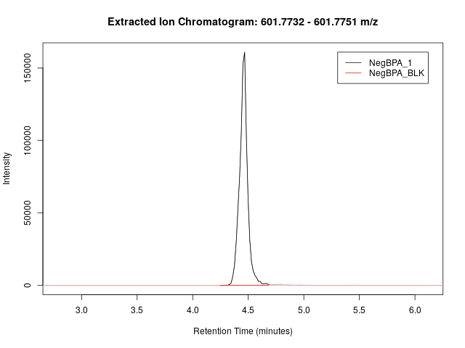
4.62
4.45
425.0126
601.7743
Low signal to noise ratio in all samples

Slide 19
BPS and BPF-Conjugates in Serum Sample – Scan Mode on 9030 Q-ToF
Serum # | Proposed analyte (ng/mL)
 | BPS | BPF | BPF-monoglucuronide | BPS-diglucuronide
1 | 10.5 | 59.4 | 17.5 | 15.7
2 | 11.5 | 107 | 16.0 | 7.4
3 | 11.1 | 63.9 | 28.8 | 4.8

